Slide 1
Introduction to- R
Presented By:
Tanuj Kumar
VIT-AP, Amaravati

Slide 2
An Introduction to R
R is a programming language and environment commonly used in statistical computing, data analytics and scientific research
It is one of the most popular languages used by statisticians, data analysts, researchers and marketers to retrieve, clean, analyze, visualize and present data.
R is easy to learn , read and write. Due to its expressive syntax and easy-to-use interface, it has grown in popularity in recent years.
R is an open source software where one can freely distribute copies of this software, read its source code, modify it.

Slide 3
Who uses R
Company | Application/Contribution
Twitter | Monitoring user experience
Ford | Analyze social media to support design decisions for their cars
New York Times | Infographics, data journalism
Microsoft | Released Microsoft R open
Human rights data analysis group | Measure the impact of war
Google | Created R style guide for the R user community inside google
Education, Healthcare, Banking, Retail, Telecom sectors

Slide 4
Is R programming an easy language.
The syntax that R uses is a bit different from other common programming languages.
We will not find ourselves writing a lot of if conditions or loops while writing code in the R language.
There are other programming constructs like vectors, lists, frames, data tables, matrices etc. that allow you to perform transformations on data in bulk.
Many researchers are learning R as their first language to solve their data analysis needs.
All you need is data and a clear intent to draw a conclusion based on the analysis

Slide 5
Alternatives to R programming
Python – Popular general purpose language
SAS (Statistical Analysis System)
IBM SPSS – Software package for statistical analysis
Python
Very powerful high-level, object-oriented programming language with an easy-to-use and simple syntax.
Extremely popular among data scientists and researchers.
Most of the packages in R have equivalent libraries in Python as well.

Slide 6
R vs Python
If you are trying to analyze a dataset and present the findings in a research paper, then R is probably a better choice.
But if you are writing a data analysis program that runs in a distributed system and interacts with lots of other components, it would be preferable to work with Python.
Installation of R
R-Console
R-Studio

Slide 7
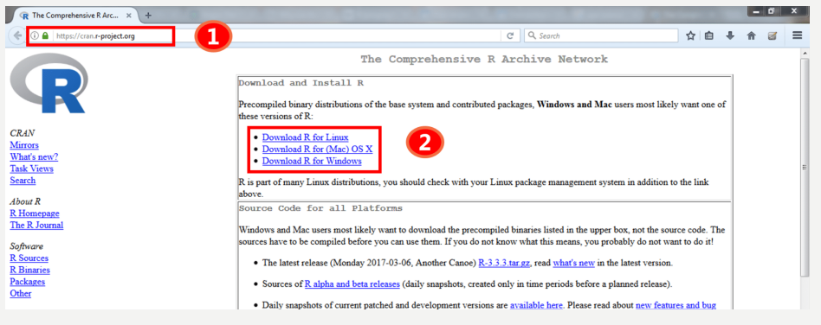
R Console
Step 1 : Go to the link- https://cran.r-project.org/
Step 2 : Download and install R (latest version) on your system.

Slide 8
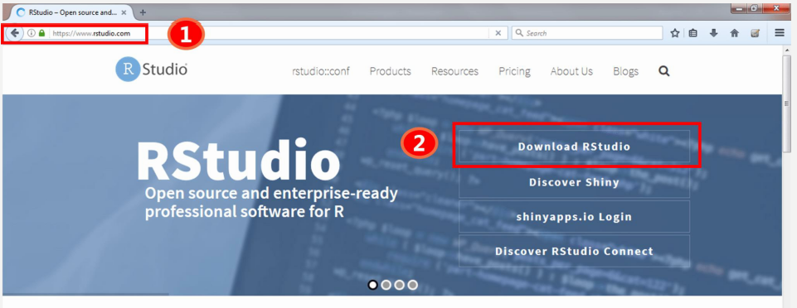
R Studio
Step 1: Go to the link-https://www.rstudio.com/

Slide 9
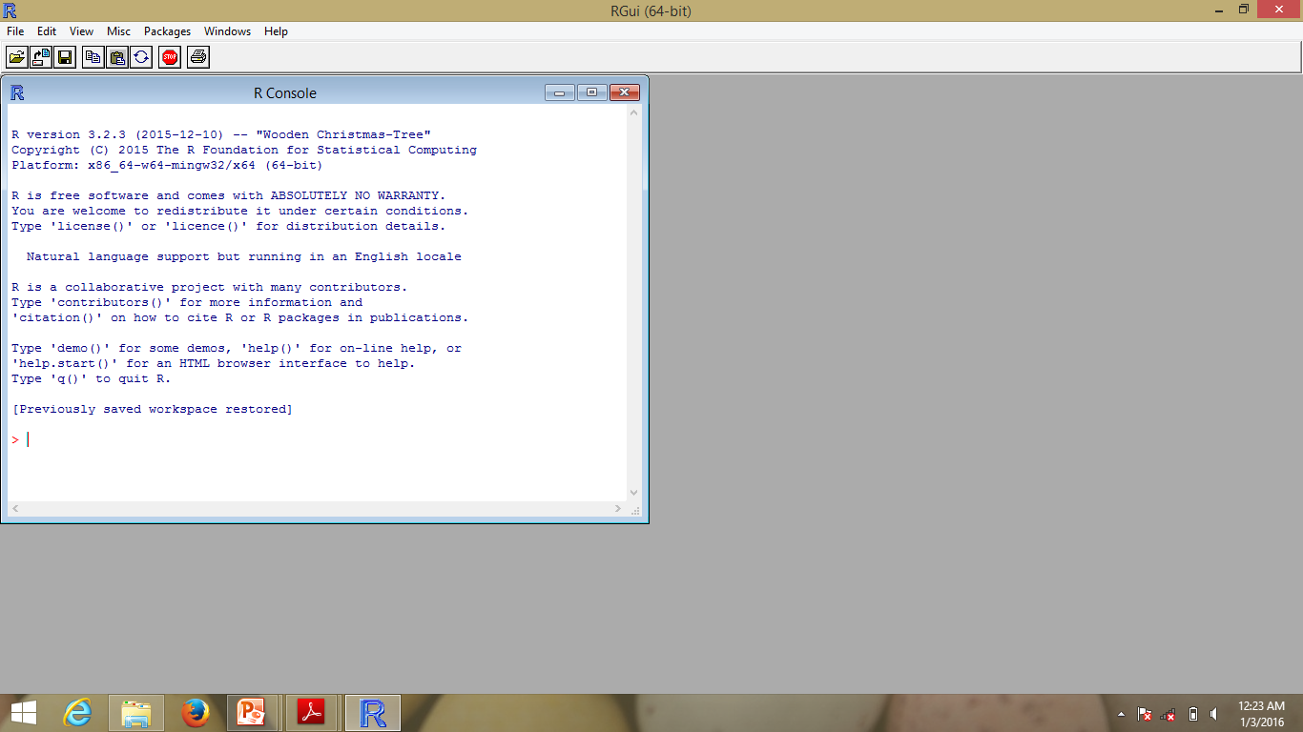
Launch R by clicking on the R icon
Figure. The R Console running in the RGui

Slide 10
Getting and setting present working directory
> getwd()
[1] "C:/Users/reg_no/Documents“
> setwd("C:\Users\reg_no\Desktop\ML")
Error: '\U' used without hex digits in character string starting ""C:\U“
> setwd("C:/Users/reg_no/Desktop/DataScience")
> getwd()
[1] "C:/Users/reg_no/Desktop/DataScience"

Slide 11
A first R Session
> 2^2
[1] 4
> 2*2
[1] 4
> log2(32)
[1] 5
> sqrt(9)
[1] 3
> mean(1:10)
[1] 5.5
> options(digits = 16)
> 10/3 # see more digits

Slide 12
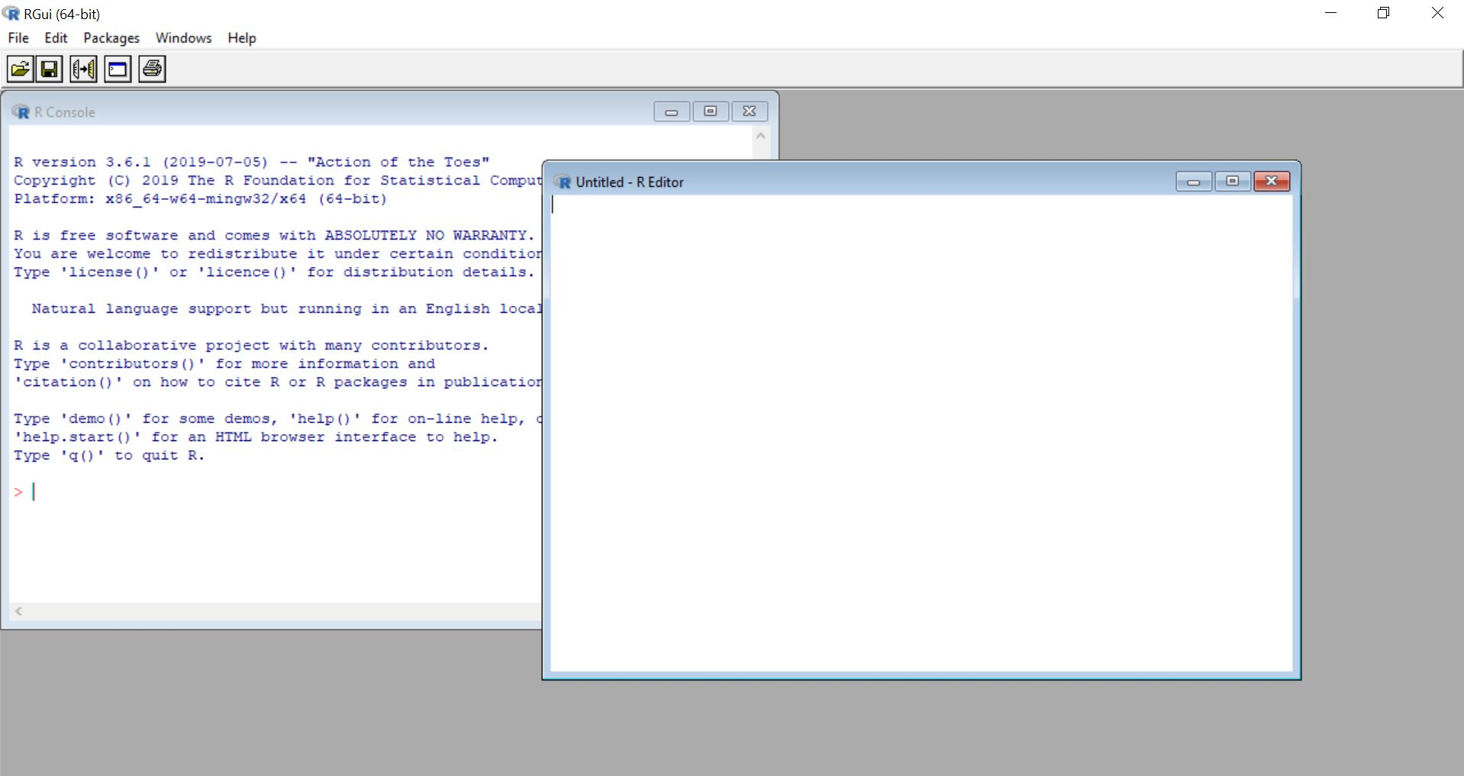
The R Editor
select File - > New script
<ctrl> + r : to run the code in R Console
<ctrl> + l : To clear the console

Slide 13
# Let’s start defining some numbers:
n1 <- 2
n2 <- 3
# We can visualize an object by typing its name, as follows:
> n1
[1] 2
# We can perform some basic operations on the objects:
> n1 + n2
[1] 5
> n1 * n2
[1] 6
# The output of any operation can be stored in another object:
> nSum <- n1 + n2
> nProd <- n1 * n2
> nSum
[1] 5

Slide 14
Basic Data Structures
Vectors
Matrices
Lists
Data Frame
Factors
Notes:
C concatenate/ combines its input

Slide 15
Vector
A vector is a sequence of data elements of the same basic type.
The most common classes are:
"character", a vector of character strings of varying length. These are normally entered and printed surrounded by double quotes.
"numeric", a vector of real numbers.
"integer", a vector of (signed) integers.
"logical", a vector of logical (true or false) values. The values are printed and as TRUE and FALSE.
Notes:
C concatenate/ combines its input

Slide 16
Vector
Creating a Vector :
1) c (concatenate)
> x <- c(10, 20, 30, 40)
> sum(x)
> length(x)
2) For mix data types, R forces the data into one mode.
> y <- c(1, 2, 3, 4, "Pi")
> y
[1] "1" "2" "3" "4" "Pi"
> mode(y)
[1] "character"
Notes:
C concatenate/ combines its input

Slide 17
Vector
Creating a Vector :
3) Repeated data; regular patterns: The seq function will generate all sorts of sequences of numbers.
It has the arguments from, to, by, and length.out
> seq(from = 1, to = 5)
[1] 1 2 3 4 5
> seq(from = 2, by = -0.1, length.out = 4)
[1] 2.0 1.9 1.8 1.7
Notes:
C concatenate/ combines its input
2) scan
This method is useful when the data are stored somewhere else.
x <- scan()

Slide 18
Vector
> 1:5
> p <- c(1:5)
> p
[1] 1 2 3 4 5

Slide 19
Vector
Extracting the elements
> x[1]
[1] 10
Extract more than one element
> x[c(1,3,4)]
[1] 10 30 40
Define a vector that contains a sequence of integers
> z = 1:10
Negative Index
Strip the member
> a= z[-4]
> z
> a
Notes:
C concatenate/ combines its input
x <- c(z, 11:15)

Slide 20
Vector Arithmetic's
Arithmetic operations of vectors are performed member wise.
> a = c(1, 3, 5, 7) > b = c(1, 2, 4, 8)
Then, if we multiply a by 5, we would get a vector with each of its members multiplied by 5.
> 5 * a [1] 5 15 25 35
Add a and b together,
> a + b [1] 2 5 9 15
Similarly for subtraction, multiplication and division,
> a - b [1] 0 1 1 -1 > a * b [1] 1 6 20 56 > a / b [1] 1.000 1.500 1.250 0.875

Slide 21
Recycling Rule
If two vectors are of unequal length, the shorter one will be recycled in order to match the longer vector.
For example, the following vectors u and v have different lengths, and their sum is computed by recycling values of the shorter vector u.
> u = c(10, 20, 30) > v = c(1, 2, 3, 4, 5, 6, 7, 8, 9) > u + v [1] 11 22 33 14 25 36 17 28 39

Slide 22
Matrices
To R, a matrix is also a vector, but a vector is not a one-column or one-row matrix.
> A = matrix( + c(2, 4, 3, 1, 5, 7), # the data elements + nrow=2, # number of rows + ncol=3, # number of columns + byrow = TRUE) # fill matrix by rows > A # print the matrix [,1] [,2] [,3] [1,] 2 4 3 [2,] 1 5 7

Slide 23
Matrix
Transpose a matrix
> B = t(A) > B # print the matrix [,1] [,2]
[1,] 2 1
[2,] 4 5
[3,] 3 7
> length(B)
> mode(B)

Slide 24
List
A list is a vector of other R objects.
Lists are used to collect together items of different classes.
i.e. an ordered collection of heterogeneous data elements.
Consist of multiple data types

Slide 25
List
> n = c(2, 3, 5) # numeric > s = c("aa", "bb", "cc", "dd", "ee") # chracter > b = c(TRUE, FALSE, TRUE, FALSE, FALSE) # logical
> x = list(n, s, b, 3) # x contains copies of n, s, b
List Slicing
> x[2] # list second member of x [[1]] [1] "aa" "bb" "cc" "dd" "ee"
> x[c(2, 4)] # list second & fourth member of x [[1]] [1] "aa" "bb" "cc" "dd" "ee" [[2]] [1] 3
Notes:
To summarize, the main difference between list and vector is that list in R allows you to gather a variety of objects under one name (that is, the name of the list) in an ordered way. These objects can be matrices, vectors, data frames, even other lists, etc. It is not even required that these objects are related to each other in any way... while the elements in a vector all have the same data type.

Slide 26
List : Member Reference
In order to reference a list member directly, use the double square bracket "[[ ]]" operator.
> x[[2]] # 2nd object of x , i.e copy of s
[1] "aa" "bb" "cc" "dd" "ee"
We can modify its content directly.
> x[[2]][1] = "ta" > x[[2]]
[1] "ta" "bb" "cc" "dd" "ee"
> s [1] "aa" "bb" "cc" "dd" "ee" # s is unaffected
Notes:
See that address[1] is a list, not an element, and that address[[1]] is an element, not a list.

Slide 27
Data Frame :
A data frame in R combines features of vectors, matrices, and lists.
Like vectors, data frames must have the same kind of data in each column.
Like matrices, data frames have both rows and columns.
Like lists, data frames allow the user to have a combination of numeric, character, and logical data.
> n = c(2, 3, 5)
> s = c("aa", "bb", "cc")
> b = c(TRUE, FALSE, TRUE)
> df = data.frame(n, s, b) # df is a data frame
> df

Slide 28
Creating a Data Frame from Vectors
The following code shows the creation of two vectors, one of which is character (the persons’ names), and the other of which is numeric (the test scores). We can then combine these two vectors into a data frame.
> people <-c("Kim","Bob","Ted","Sue","Liz","Amanada","Tricia","Johnathan","Luis","Isabel")
> scores <-c(17,19,24,25,16,15,23,24,29,17)

Slide 29
> people
[1] "Kim" "Bob" "Ted" "Sue" "Liz" "Amanada"
[7] "Tricia" "Jonathan" "Luis" "Isabel"
> scores
[1] 17 19 24 25 16 15 23 24 29 17

Slide 30
create a data frame from the two vectors.
quiz_scores <- data.frame(people, scores)
> quiz_scores
people scores
1 Kim 17
2 Bob 19
3 Ted 24
4 Sue 25
5 Liz 16
6 Amanada 15
7 Tricia 23
8 Johathan 24
9 Luis 29
10 Isabel 17

Slide 31
Removing the objects:
We can remove any unwanted objects in the workspace by using the rm() function.
Because we now have a data frame, we no longer need the separate vectors from which the data frame was created.
> rm(people,scores)
> people
Error: object 'people' not found
> scores
Error: object 'scores' not found

Slide 32
How to obtain vector from dataframe
1] Obtain individual columns by using the column index in square brackets
> quiz_scores[2]
scores
1 17
2 19
3 24
4 25
5 16
6 15
7 23
8 24
9 29
10 17

Slide 33
How to obtain vector from dataframe
2] Employ the data frame name followed by a $ sign and the column name.
Finally, we can apply the attach() command to gain immediate access to our columns as vectors
> quiz_scores$scores
[1] 17 19 24 25 16 15 23 24 29 17
> attach(quiz_scores)
> scores
[1] 17 19 24 25 16 15 23 24 29 17

Slide 34
Factors:
Conceptually, factors are variables in R which take on a limited number of different values;
Referred to as categorical variables.
This R object contains a variable whose value belongs to a defined set of values known as levels.
Each level is associated with an integer and the data can be treated as integers or characters that obtain the same result.

Slide 35
Factors:
citizen <- factor(c("uk", "us","in","au", "uk", "us", "us"))
> citizen
[1] uk us in au uk us us
Levels: au in uk us
> unclass(citizen) # assign integer values in
alphabetical order
[1] 3 4 2 1 3 4 4
attr(,"levels")
[1] "au" "in" "uk" "us"

Slide 36
Factors:
> table(citizen)
citizen
au in uk us
1 1 2 3

Slide 37
Factors Ordered:
> income <- ordered(c("Mid", "Hi", "Lo", "Mid", "Lo", "Hi"), levels = c("Lo", "Mid", "Hi"))
> income
[1] Mid Hi Lo Mid Lo Hi
Levels: Lo < Mid < Hi
> as.numeric(income)
[1] 2 3 1 2 1 3

Slide 38
Functions
A function takes arguments as input and returns an object as output.
> x <- 1:5
> sum(x)
[1] 15
> length(x)
[1] 5
> min(x)
[1] 1
> mean(x) # sample mean
[1] 3
> sd(x) # sample standard deviation
[1] 1.581139

Slide 39
Functions
define a vector x1 with the integer numbers between 1 and 10,
and a function, func1, which returns the square of the input:
> x1 <- 1:10
> func1 <- function(el){
result <- el ^ 2
return(result)
}
> func1(3)
> func1(x1)

Slide 40
Reading Data
reading a comma-separated value (CSV) file into an R data frame
>data = read.csv('student.csv', sep = ",", header=TRUE)
#header=true means first line is header
> head(data)
> class(data)
#printing data frame
> print(data)
#obtaining row from data frame
> row1 = as.vector( data[1,])
>col3=as.vector(data[3])
>print(row1) #printing row
>print(col3) #printing column

Slide 41
Reading Data
#names gives column headings
> names(data)
> x=names(data)
>print(x)
[1] "ROLL_NUMBER" "NAME" "DOB" "percentage_marks" "favourite_color" "maths" "physics" "chemistry"
> print(x[1]);
[1] "ROLL_NUMBER"
# dim gives dimension
> dim(data)

Slide 42
Reading Data
#accessing columns
> col1=data[,2]
> print(col1)
> col5=data[,5]
> print(col5)
[1] black red orange red black red black orange red orange
Levels: black orange red
> table(col5)
col5
black orange red
3 3 4

Slide 43
Data Import:
Reading the data from the files like Text files, CSV files, Excel files, Spreadsheet files, SAS databases, ODBC databases, etc.
Data Import Functions:
read.table() # read table-format data
read.csv() # read comma separated values
read.delim() # read tab-delimited data
scan() # read data directly into a vector or a list

Slide 44
Data Import:
Example:
> read.table(“info.txt") # text file
> read.table(file.choose())
> read.csv(‘student.csv’) # csv file
>x <− scan() # reads the number of inputted items

Slide 45
Loops
FOR Loop:
> i <− c(1:5)
> for (n in i) print(n * 10)
While Loop:
> even <− 0
> while(even < 10) {
even <− even + 2
print(even) }
Repeat Loop
> i <− 1
> repeat {
print(i)
i <− i + 1
if(i > 5)
{break}
}

Slide 46
Installation & Use of Packages
There are different R packages that provide users with general-purpose functions and specific techniques.
Some packages are already installed in the basic version of R.
in order to use extra packages , we need to download them from the official CRAN repository using install.packages
> install.packages('data.table')

Slide 47
Installation & Use of Packages
# Check installed R packages
> library()
# Load the package
> library(data.table)
# Check the Loaded package
> search()

Slide 48
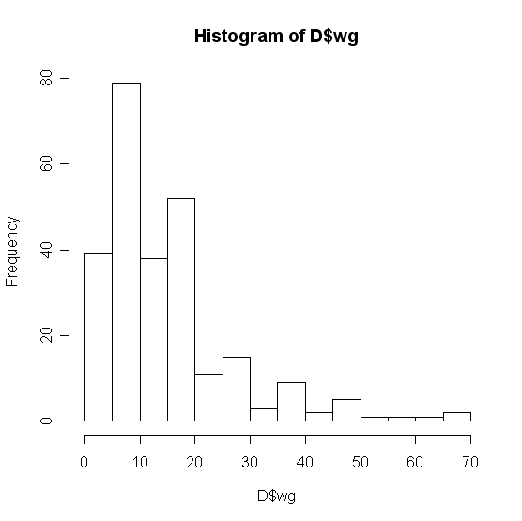
Basic Graphics
Histogram
hist(D$wg)

Slide 49
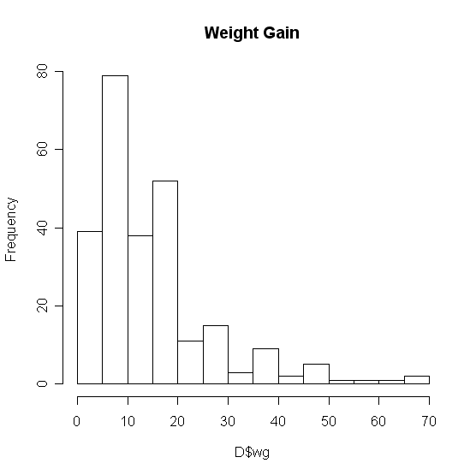
Basic Graphics
Add a title…
The “main” statement will give the plot an overall heading.
hist(D$wg , main=‘Weight Gain’)

Slide 50
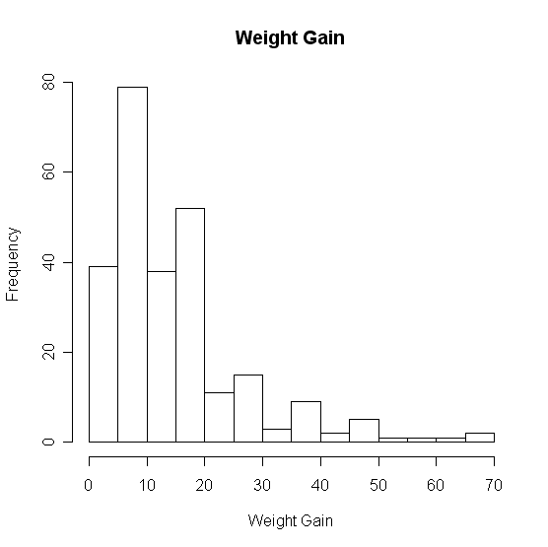
Basic Graphics
Adding axis labels…
Use “xlab” and “ylab” to label the X and Y axes, respectively.
hist(D$wg , main=‘Weight Gain’,xlab=‘Weight Gain’, ylab =‘Frequency’)

Slide 51
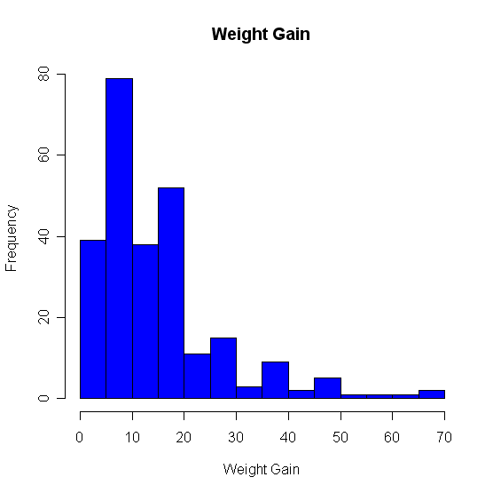
Basic Graphics
Changing colors…
Use the col statement.
colors will give you help on the colors.
Common colors may simply put in using the name.
hist(D$wg, main=“Weight Gain”,xlab=“Weight Gain”, ylab =“Frequency”, col=“blue”)

Slide 52
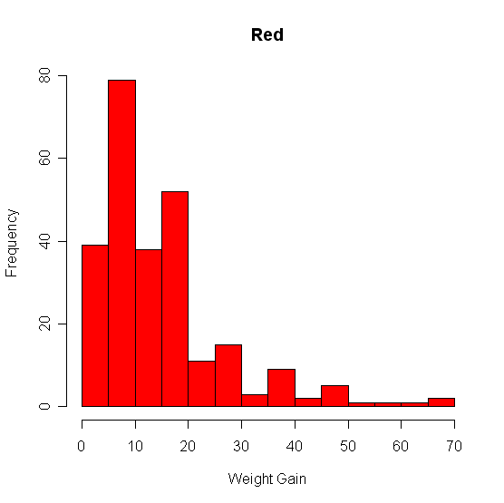
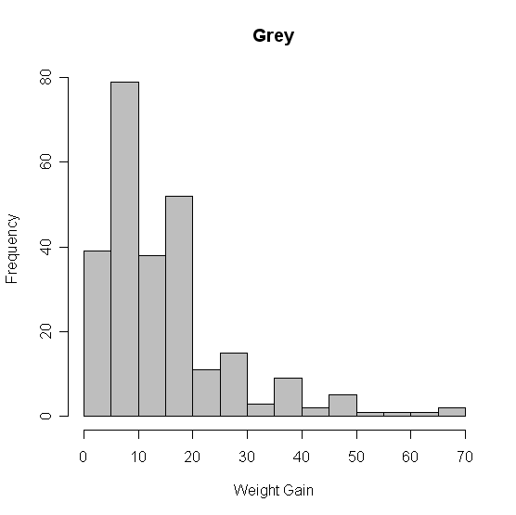
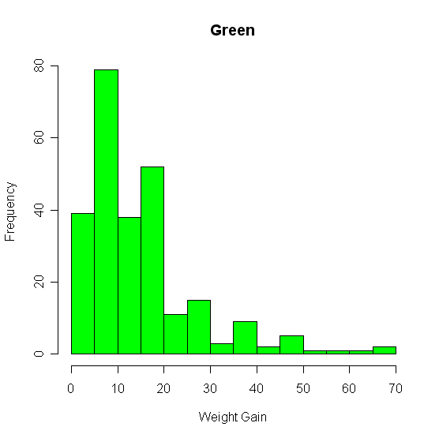
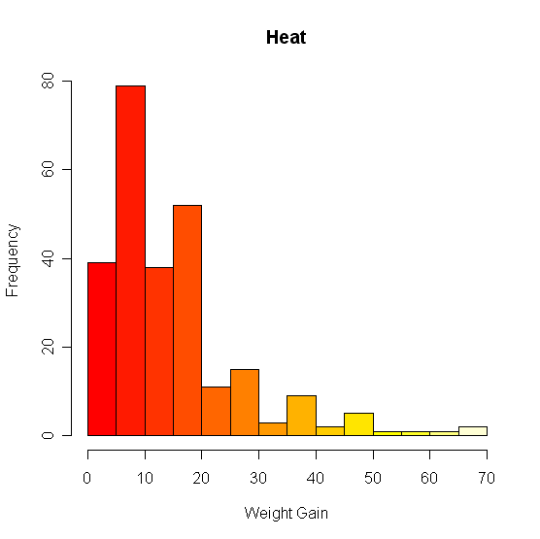
Basic Graphics – Colors

Slide 53
Scatter Plots
Suppose we have two variables and we wish to see the relationship between them.
A scatter plot works very well.
R code:
plot(x,y)
Example
plot(D$metmin,D$wg)

Slide 54
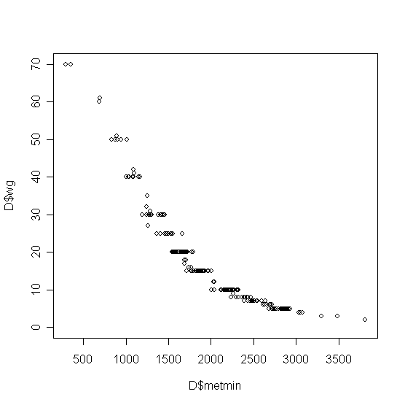
Scatterplots

Slide 55
Paneling Graphics
Suppose we want more than one graphic on a panel.
We can partition the graphics panel to give us a framework in which to panel our plots.
par(mfrow = c( nrow, ncol))

Slide 56
Binomial Distribution
dbinom(x, size, prob) #dbinom gives the density
pbinom(x,size,prob,lower.tail=TRUE) #pbinom gives the distribution function
qbinom(x,size,prob,lower.tail=TRUE) #qbinom gives the quantile function
rbinom(x,size,prob) #rbinom generates random deviates.

Slide 57
Example:
Five terminals on an on-line computer system are attached to a communication line to the central computer system. The probability that any terminal is ready to transmit is 0.95. Let X denote the number of ready terminals. Find the probability of getting exactly 3 ready terminals.
dbinom(3,5,0.95)

Slide 58
Poisson Distribution
dpois(x, lambda)
ppois(x, lambda, lower.tail=TRUE)
qpois(x, lambda, lower.tail=TRUE)
rpois(x, lambda)

Slide 59
Normal Distribution
dnorm(x, mean=0, sd=1)
pnorm(x, mean=0, sd=1, lower.tail=TRUE)
qnorm(x, mean=0, sd=1, lower.tail=TRUE)
rnorm(x, mean=0, sd=1)

Slide 60
Visualizing Normal Curve
hist(x)
curve(dnorm(x,mean(x),sd(x))

Slide 61
T-test
t.test(x,y=NULL,alternative=c(“two.sided”,”less”,”greater”), mu=0, paired=FALSE, var.equal=FALSE, conf.level=0.95)

Slide 62
Example
Suppose that 10 volunteers have taken an intelligence test; here are the results obtained. The average score of the entire population is 75 in the same test. Is there any significant difference (with a significance level of 95% ) between the sample and population means, assuming that the variance of the population is not known.
Scores: 65, 78, 88, 55, 48, 95, 66, 57, 79, 81.

Slide 63
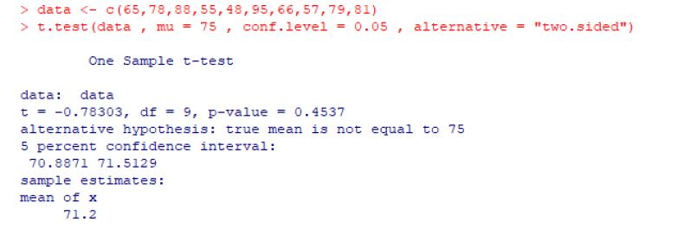

Slide 64
Fitting Linear Model
lm(y~x)
lm(x~y)

Slide 65
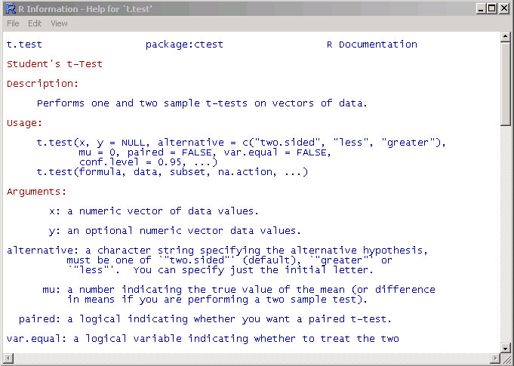
Getting help
Details about a specific command whose name you know (input arguments, options, algorithm, results):
>? t.test
or
>help(t.test)

Slide 66
References
Beginning R, An Introduction to Statistical Programming by Larry Pace (Apess)
http://www.r-project.org/
http://cran.r-project.org/

